Slide 1
CSE 574 Lecture 7: Value Iteration and Policy Iteration for MDPs
Professor: Stephanie Gil
Email: sgil@asu.edu (Office hours M 12-1pm BYENG 386)
TAs: Sushmita Bhattacharya sbhatt55@asu.edu (Office hours M 5-6 BYENG 392)
Weiying Wang wwang239@asu.edu (Office hours Th 2:30-3:30 BYENG 392)

Slide 2
Last Time:
HW 2 due this Friday– any questions?
Office hours tomorrow 2:30-3:30 with Weiying in BYENG 395
Midterm moved to Oct 3rd in class
Last time: Markov Models and Markov Decision Processes
Reading Sutton and Barto text “Reinforcement Learning, An Introduction” Second Edition (2017), chapter 3 (available online)
Next time: Dynamic Programming and Optimal Control Vol 1
Provided by Dimitri Bertsekas on our Blackboard site!
Please note that this material is copyrighted and not authorized for sharing or posting outside of this class

Slide 3
Example: A Maze
States S={1,2,…,18}
Actions A={N,E,S,W}
Partially expanded state space?
Why is the reward negative?
How to solve for the best path?
BFS?
A*?
Dynamic Programming!

Slide 4
Solving the Maze
What are good states? What are good actions?
This is defined in terms of expected reward – this is estimated via value functions
Policy – A mapping from states to probabilities of selecting each possible action. You can think of this as a strategy…
What about state 7?
Is state 3 a good state?
Does the value of a state depend on the subsequent action? Or policy?

Slide 5
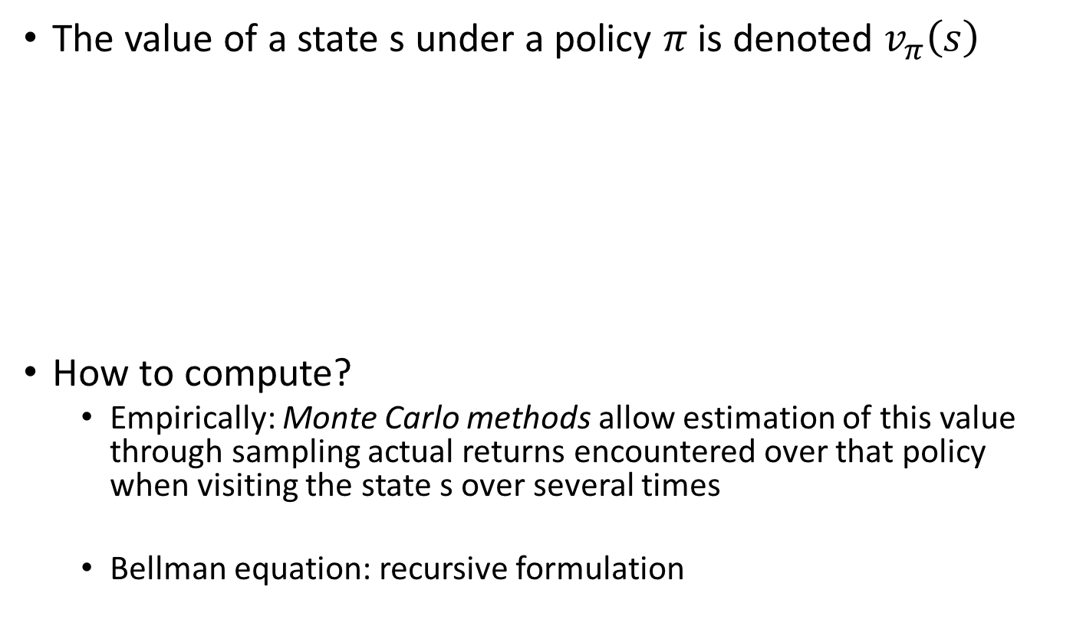
Policies and the Value of a State
The value of a state s under a policy $π$ is denoted $v_{π}\left(s\right)$
How to compute?
Empirically: Monte Carlo methods allow estimation of this value through sampling actual returns encountered over that policy when visiting the state s over several times
Bellman equation: recursive formulation
Defines the probability of choosing action a given the state

Slide 6

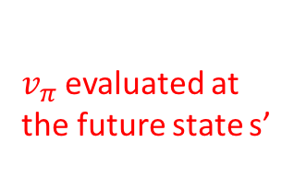

Bellman Equation for $v_{π}$
A recursion for the value of a state under policy $π$
$v_{π}$evaluated at the future state s’

Slide 7
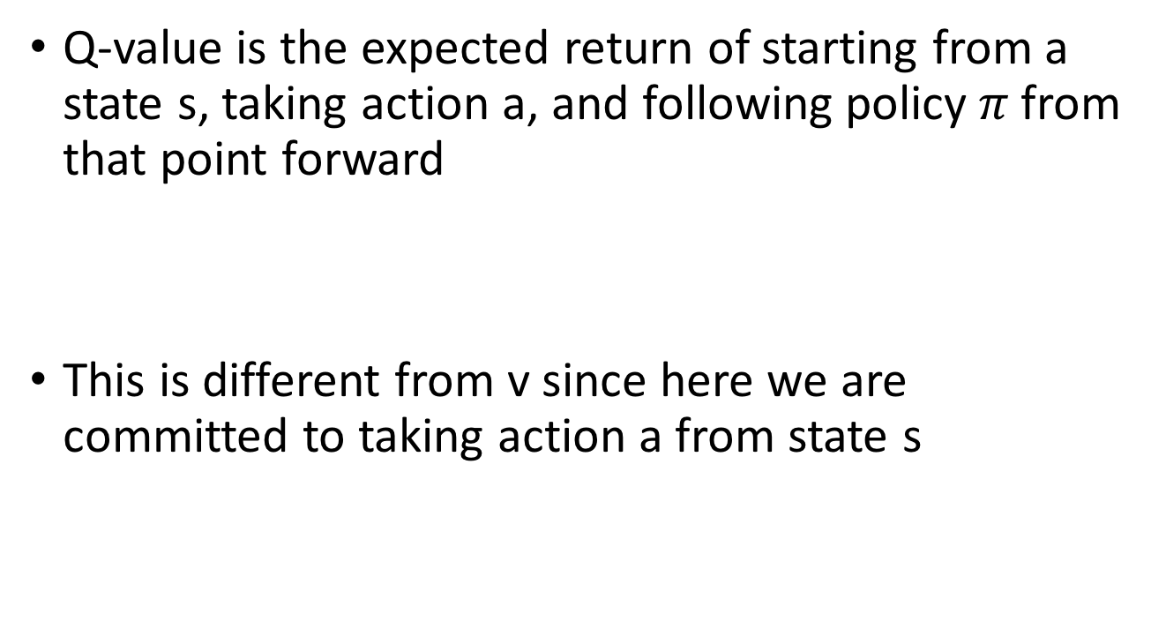
Q-Values
Q-value is the expected return of starting from a state s, taking action a, and following policy$π$from that point forward
This is different from v since here we are committed to taking action a from state s
s
a
Choice of action
(agent)
stochasticity
s,a
Q-state
Stochastic state selection (environment)
s’

Slide 8
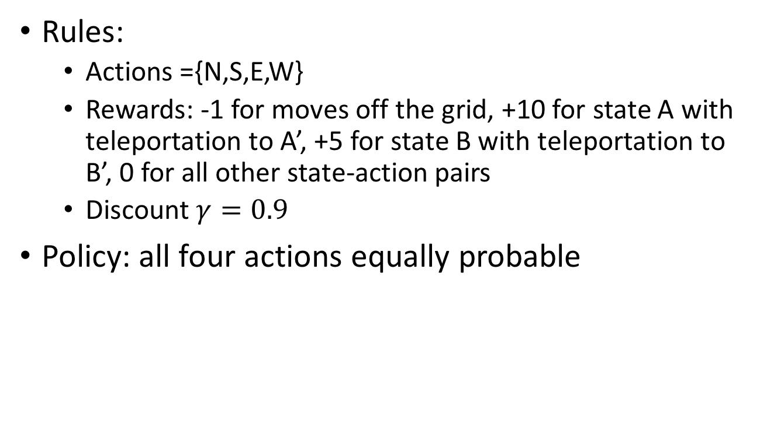
Example: Gridworld
Rules:
Actions ={N,S,E,W}
Rewards: -1 for moves off the grid, +10 for state A with teleportation to A’, +5 for state B with teleportation to B’, 0 for all other state-action pairs
Discount $γ=0.9$
Policy: all four actions equally probable
Figure 3.3 Sutton and Barto text

Slide 9
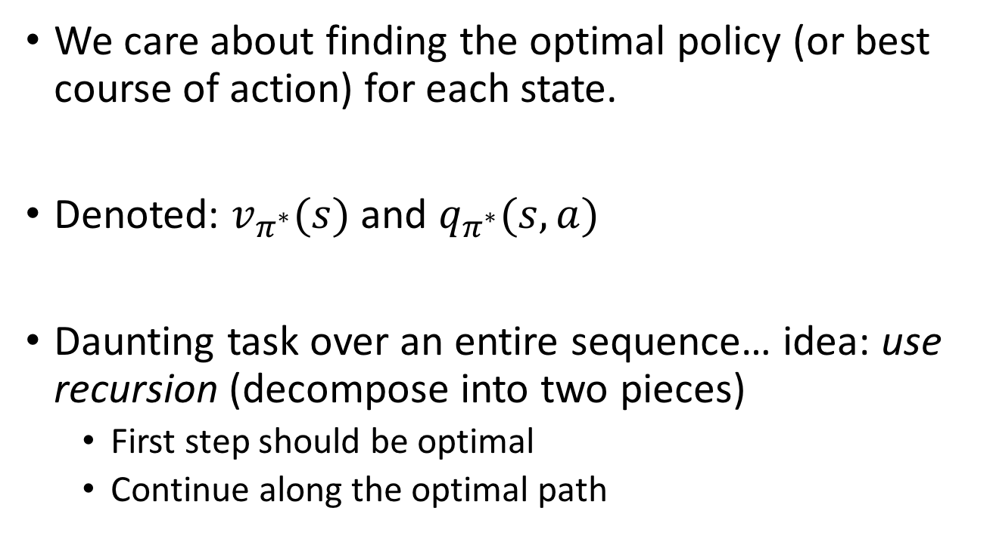
Optimal Policies
We care about finding the optimal policy (or best course of action) for each state.
Denoted: $v_{π^{∗}}(s)$ and $q_{π^{∗}}(s,a)$
Daunting task over an entire sequence… idea: use recursion (decompose into two pieces)
First step should be optimal
Continue along the optimal path

Slide 10
Example: Another Gridworld
Non-deterministic actions (80% success)
“Living” negative reward of -0.04 for every action
Terminal (absorbing) states have rewards +1, -1
Figure 17.1 in Russell and Norvig text

Slide 11

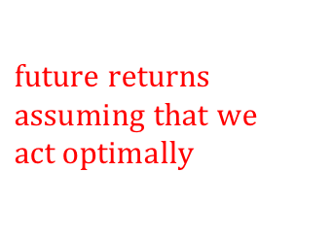

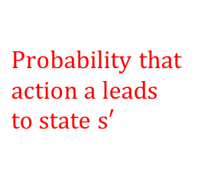
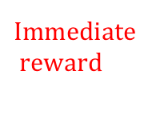
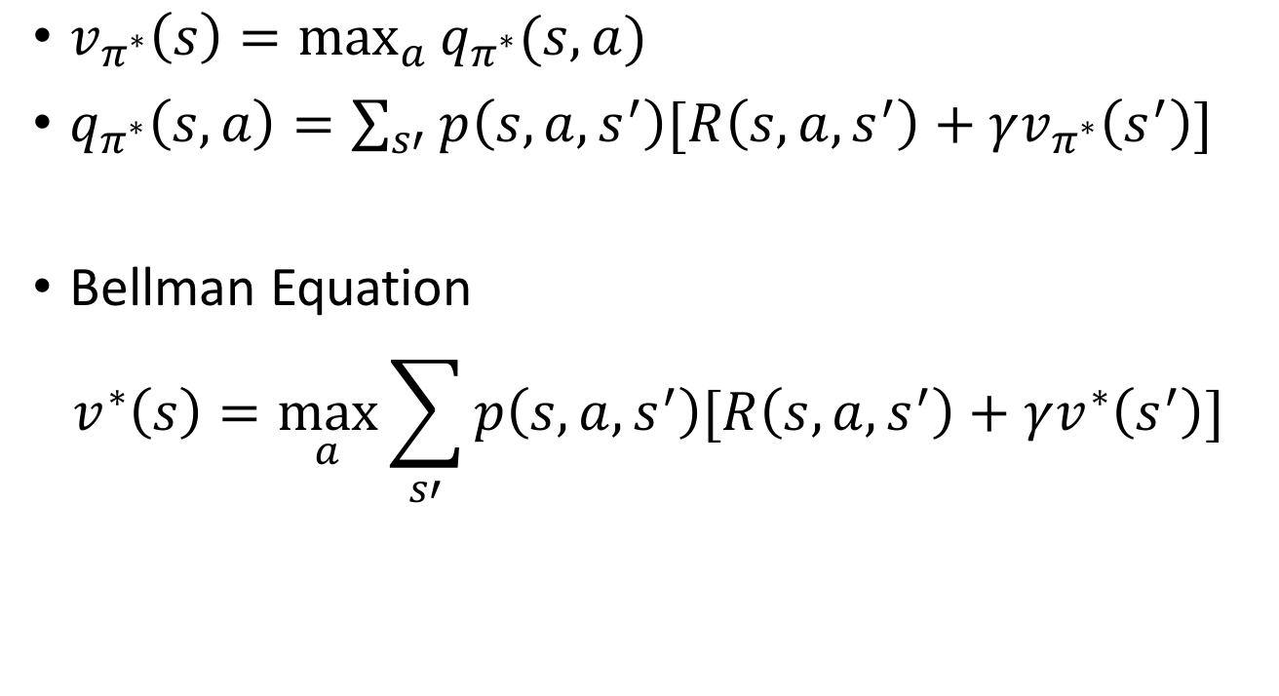
Bellman Equations
$v_{π^{∗}}\left(s\right)=\max_{a}{q_{π^{∗}}(s,a)}$
$q_{π^{∗}}\left(s,a\right)=\sum_{s′}{p\left(s,a,s^{′}\right)[R\left(s,a,s^{′}\right)+γv_{π^{∗}}\left(s^{′}\right)]}$
Bellman Equation
$$v_{ }^{∗}\left(s\right)=\max_{a}{\sum_{s′}{p\left(s,a,s^{′}\right)[R\left(s,a,s^{′}\right)+γv^{∗}\left(s^{′}\right)]}}$$
$$Immediate$$
$$reward$$
$$discounted$$
$$Probability that$$
$$action a leads$$
$$to state s′$$
$$future returns$$
$$assuming that we$$
$$act optimally$$
$$π^{∗}$$

Slide 12
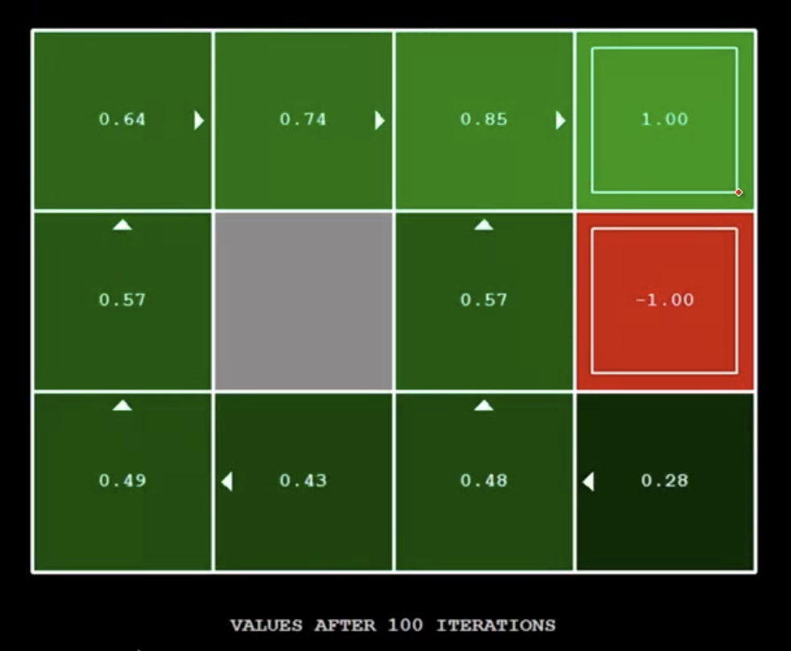
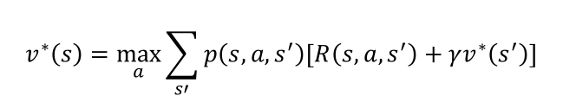
Simple Gridworld V-values
$$v_{ }^{∗}\left(s\right)=\max_{a}{\sum_{s′}{p\left(s,a,s^{′}\right)[R\left(s,a,s^{′}\right)+γv^{∗}\left(s^{′}\right)]}}$$
Figure 17.1 in Russell and Norvig text
CS188 Spring 2014 Berkeley AI Lectures

Slide 13
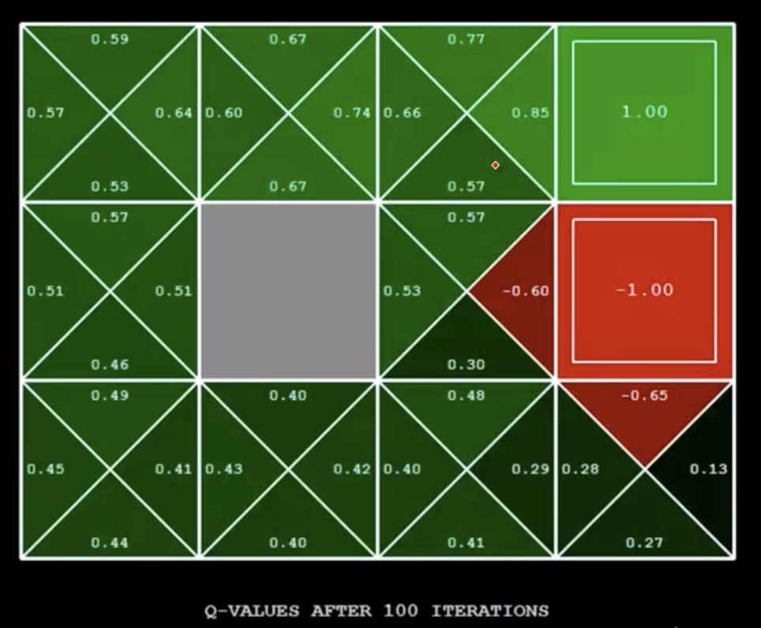
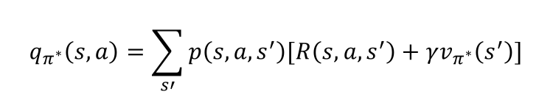
Simple Gridworld Q-values
$$q_{π^{∗}}\left(s,a\right)=\sum_{s′}{p\left(s,a,s^{′}\right)[R\left(s,a,s^{′}\right)+γv_{π^{∗}}\left(s^{′}\right)]}$$
Figure 17.1 in Russell and Norvig text
CS188 Spring 2014 Berkeley AI Lectures

Slide 14


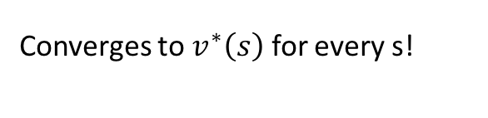
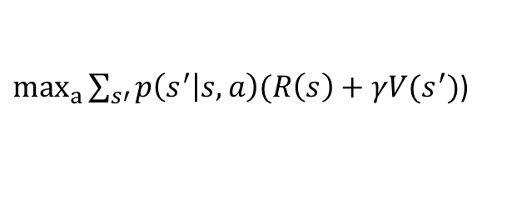

Value Iteration
How to compute $v_{ }^{∗}\left(s\right)$?
Recursive estimation of the value of a state s
Walk-through an evaluation
$$R\left(s\right)$$
If s is a terminal state
$$V\left(s\right)$$
$\max_{a}{\sum_{s′}{p\left(s^{′} | s,a\right)(R\left(s\right)+γV(s^{′})}}$)
Converges to $v_{ }^{∗}\left(s\right)$ for every s!

Slide 15
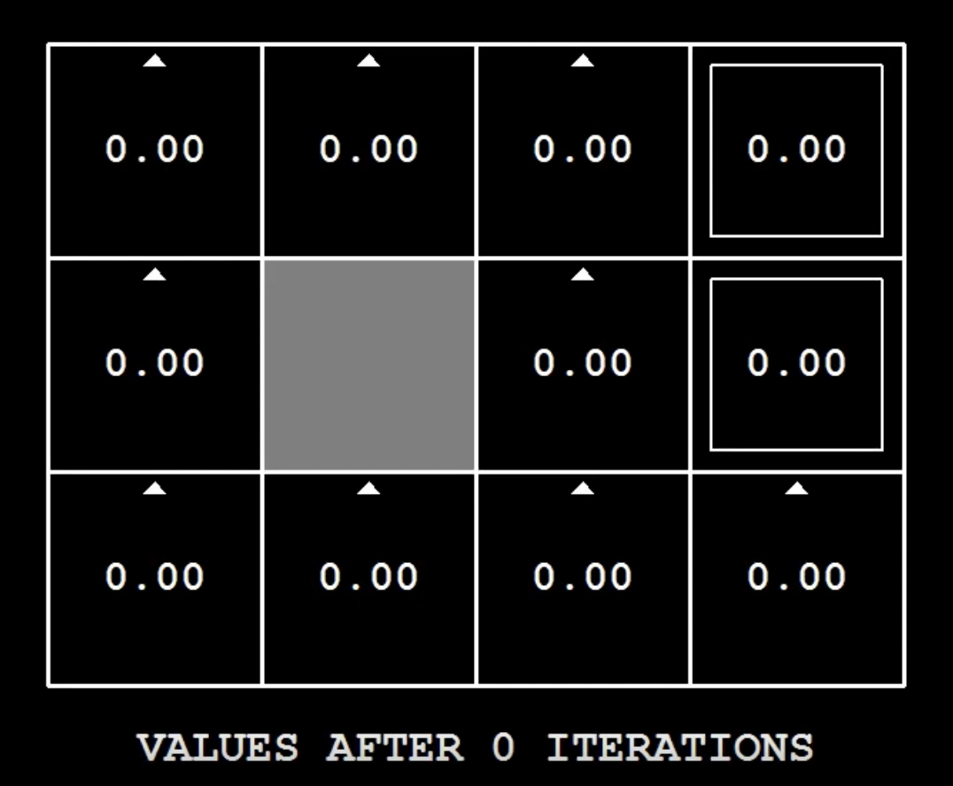

Value Iteration
How to compute $v_{ }^{∗}\left(s\right)$?
Recursive estimation of the value of a state s
The number of iterations k is like the depth of your search tree (how many actions you can take)
$$R\left(s\right)$$
If s is a terminal state
$$V\left(s\right)$$
$\max_{a}{\sum_{s′}{p\left(s^{′} | s,a\right)(R\left(s\right)+γV(s^{′})}}$)
Converges to $v_{ }^{∗}\left(s\right)$ for every s!
CS188 Spring 2014 Berkeley AI Lectures

Slide 16
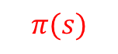
Policy Evaluation
Question: how to compare different policies? How to determine which is the better policy?
Optimal policy
Fixed policy
s
Choice of action
(agent)
s
a
$$π(s)$$
Fixed action
stochasticity
s,a
Stochastic state selection (environment)
Stochastic state selection (environment)
s’
s’

Slide 17
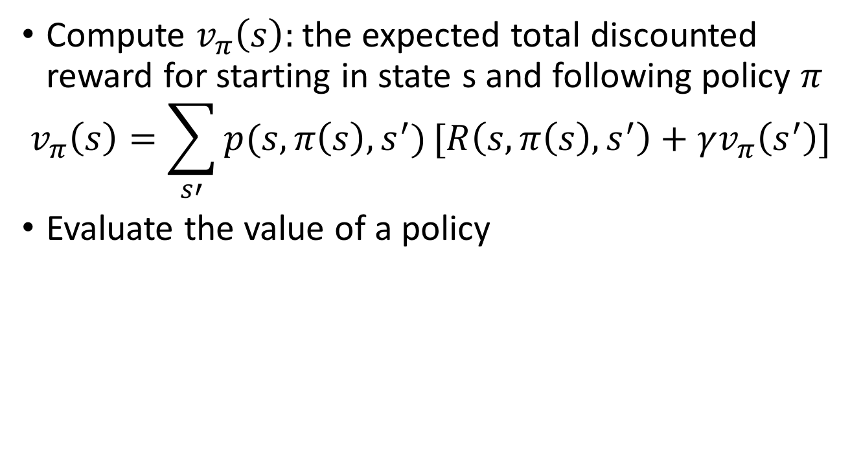
Policy Evaluation
Compute $v_{π}\left(s\right):$the expected total discounted reward for starting in state s and following policy $π$
$$v_{π}\left(s\right)=\sum_{s′}{p(s,π\left(s\right),s^{′})}[R\left(s,π\left(s\right),s^{′}\right)+γv_{π}\left(s^{′}\right)]$$
Evaluate the value of a policy

Slide 18



Value Iteration vs. Policy Evaluation
Evaluation
Value iteration
Policy evaluation
Complexity
Value iteration is $O(s^{2}A)$versus policy evaluation $O\left(s^{2}\right)$
$$v\left(s\right)=\max_{a}{\sum_{s′}{p\left(s^{′} | s,a\right)[R\left(s′\right)+γv\left(s^{′}\right)]}}$$
$$v_{π}\left(s\right)=\sum_{s′}{p(s,π\left(s\right),s^{′})}[R\left(s,π\left(s\right),s^{′}\right)+γv_{π}\left(s^{′}\right)]$$

Slide 19
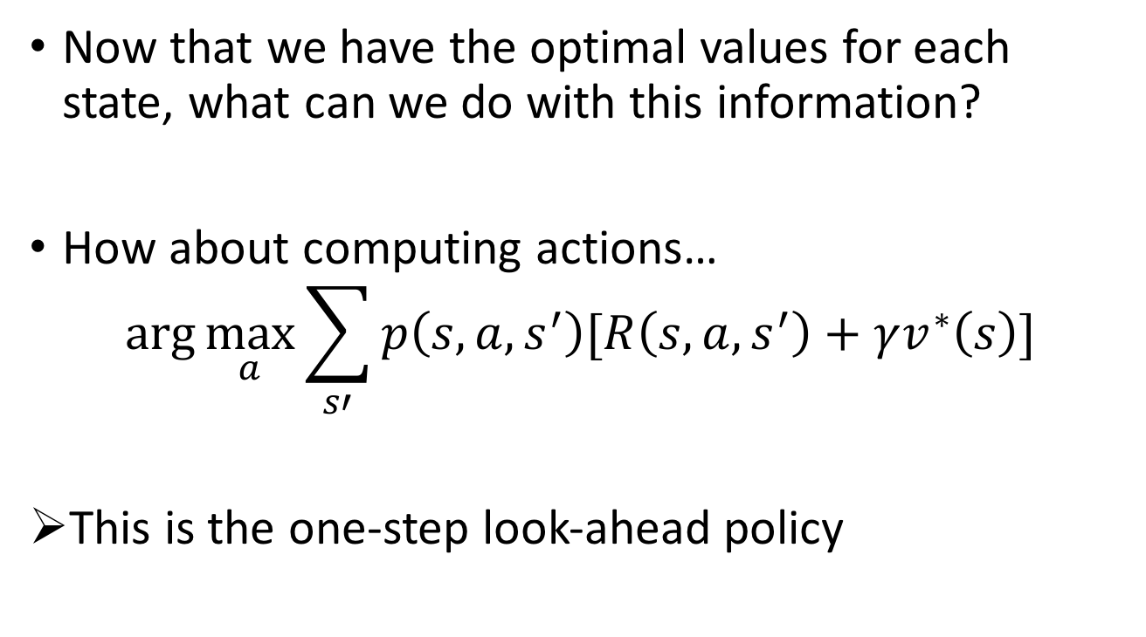
Computing Actions from Values
Now that we have the optimal values for each state, what can we do with this information?
How about computing actions…
$$\arg{\max_{a}{\sum_{s′}{p\left(s,a,s^{′}\right)[R\left(s,a,s^{′}\right)+γv^{∗}\left(s\right)]}}}$$
This is the one-step look-ahead policy

Slide 20
Policy Iteration
Another way to solve MDPs:
Step 1: Policy Evaluation – calculate utilities for some fixed policy (not the optimal one) until convergence
Step 2: Policy Improvement – update policy using one-step look-ahead with resulting converged (but not optimal) utilities as future values
Repeat until convergence
Policy iteration is still optimal!

Slide 21
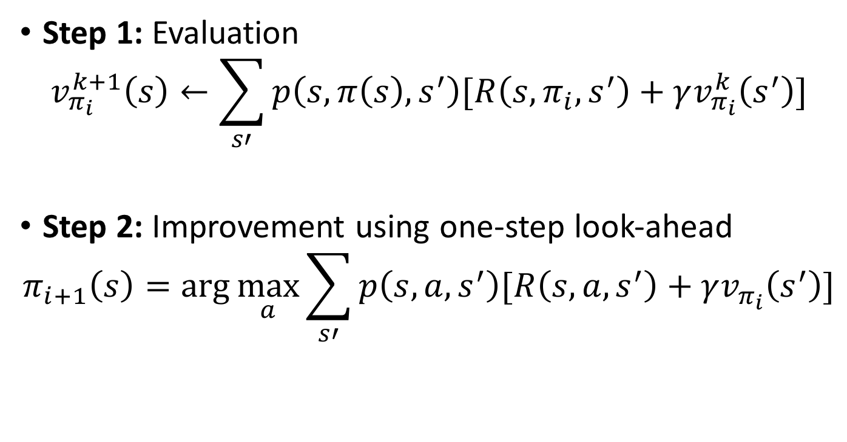
Policy Iteration Equations
Step 1: Evaluation
$$v_{π_{i}}^{k+1}\left(s\right)←\sum_{s′}{p\left(s,π\left(s\right),s^{′}\right)[R\left(s,π_{i},s^{′}\right)+γv_{π_{i}}^{k}\left(s^{′}\right)]}$$
Step 2: Improvement using one-step look-ahead
$$π_{i+1}\left(s\right)=\arg{\max_{a}{\sum_{s′}{p\left(s,a,s^{′}\right)[R\left(s,a,s^{′}\right)+γv_{π_{i}}\left(s^{′}\right)]}}}$$
Improvement one step at a time – only change the policy in a way that is guaranteed to be better (because of the max)

Slide 22


Policy Iteration
Step 2: Improvement using one-step look-ahead
$$π_{i+1}\left(s\right)=\arg{\max_{a}{\sum_{s′}{p\left(s,a,s^{′}\right)[R\left(s,a,s^{′}\right)+γv_{π_{i}}\left(s^{′}\right)]}}}$$
$$π_{i}$$

Slide 23
Using these tools you want to…
Compute optimal values using value iteration or policy iteration
Compute values for a particular policy using policy evaluation
Turn your values into a policy using policy extraction or one-step look-ahead

Slide 24
Relation to Dynamic Programming
First example of dynamic programming
Dynamic programming applicable to general class of problems
We will explore this in the next lectures

Slide 25
Final Project Review
Final project 35%
Final project breakdown:
Proposal (P/F)
Literature Review 5%
Report (8 pages IEEE format) 15%
Presentation 15%

Slide 26
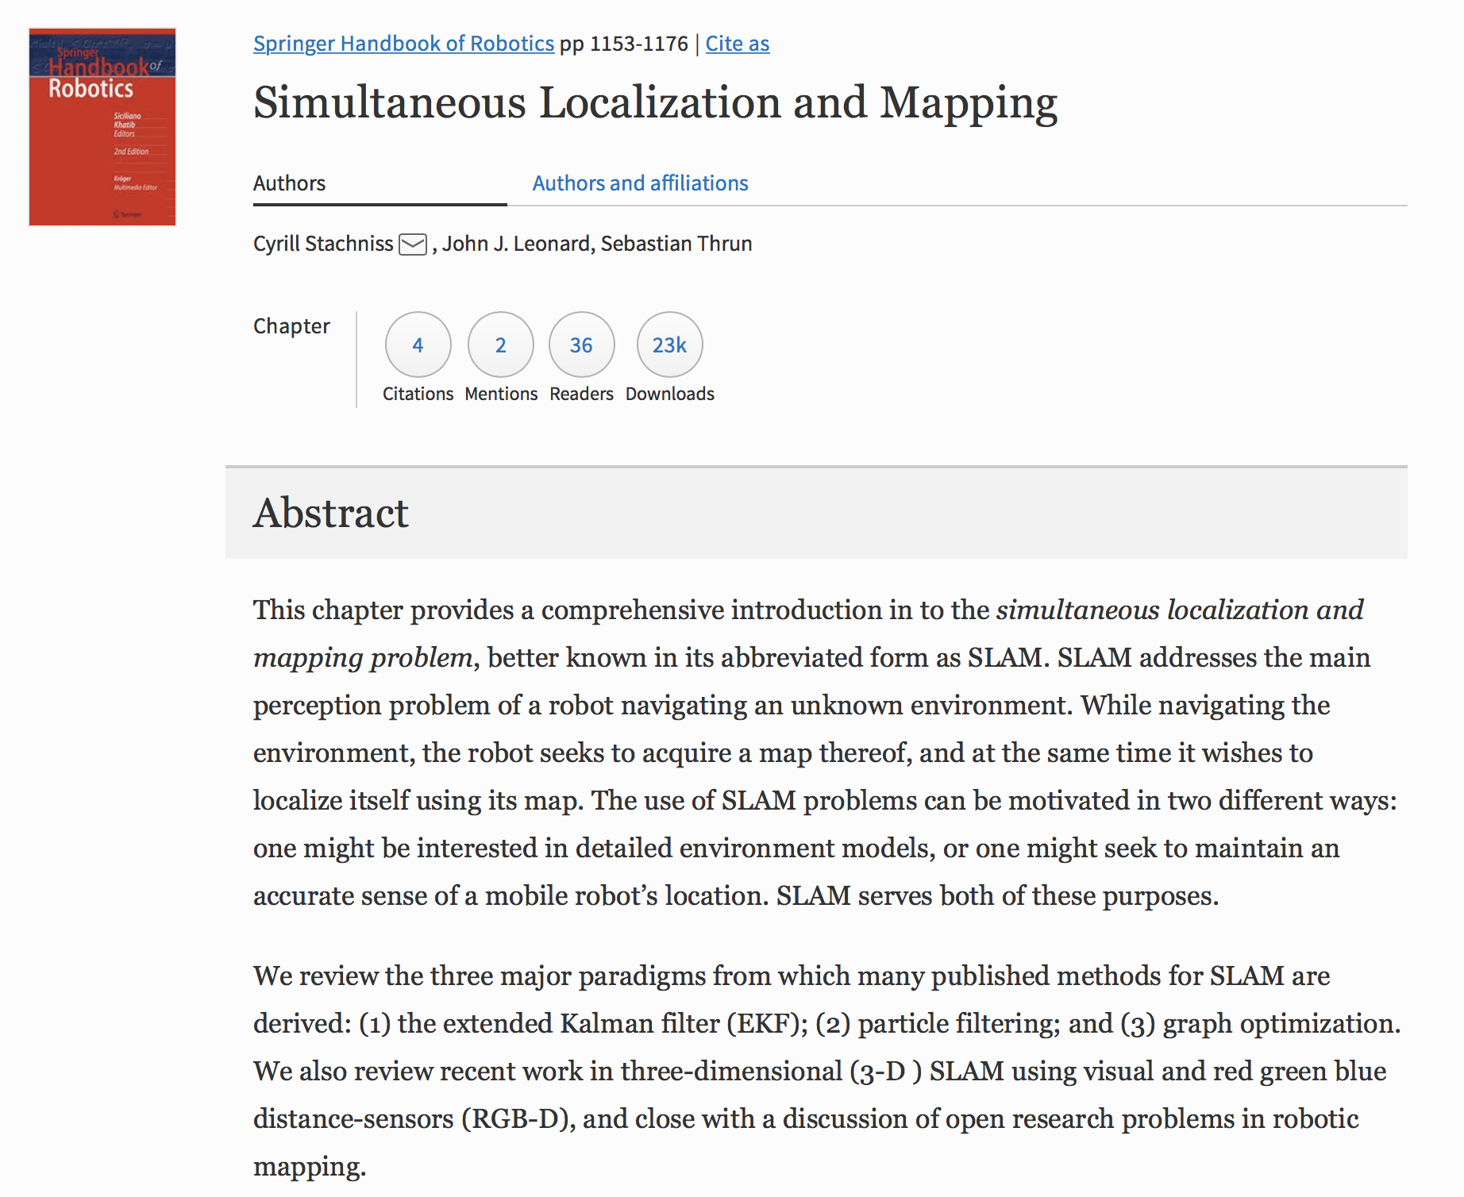
How to Pick a Final Project Topic
Problem Representation and Search
State space and how to model problems
SAT/CSP/IP based planning and graph search
Adversarial search
Markov Processes
Markov models
Markov decision processes
Online planning
Intro to Dynamic Programming
Shortest path problems
Optimal control
Minimax problems
Hidden Markov Models
Modeling using HMMs
Partially Observable Markov Decision Processes (POMDPs)
Multi-agent Planning
Motion Planning
Bug Algorithms
Potential Field Methods
Sampling Based Motion Planning
Localization and Mapping
Robot Localization
Intro to Simultaneous Localization and Mapping (SLAM)
Reinforcement Learning (Approximate Dynamic Programming)

Slide 27
Final Project Review
Final project 35%
Final project breakdown:
Proposal (P/F)
Literature Review 5%
Report (8 pages IEEE format) 15%
Presentation 15%
Discuss the strengths and limitations of your paper’s this method. Compare to other papers in the field (minimum of 5). Include preliminary simulation data for your implementation.

Slide 28
Final Project Review
Final project 35%
Final project breakdown:
Proposal (P/F)
Literature Review 5%
Report (8 pages IEEE format) 15%
Presentation 15%
Your report should include:
Simulation plots of your benchmark algorithm
Your extension of the work. This can be addressing limitations or exposing limitations

Slide 29
Final Project Review
Final project 35%
Final project breakdown:
Proposal (P/F)
Literature Review 5%
Report (8 pages IEEE format) 15%
Presentation 15%
Your presentation should include:
Comparison of your paper to the state of the art
Your benchmark simulation results
Your extended results beyond what exists in the paper
An explanation of how your results are different and what their significance is

Slide 30
Next Time…
HW 2 due Friday (Sept 14th at 5pm)
Introduction to Dynamic Programming
Readings will be posted on Blackboard → special access made possible by Prof. Dimitri Bertsekas to his Dynamic Programming and Optimal Control text!

